Slide 1
Comprehensive Design Review
  SDP Team 6
  Sanghoon Lee
  David Meschisen
  Jori Platt
  Minwo Wang

Slide 2




The Team
Sanghoon Lee
Microcontroller
Camera
IOIO
David Meschisen
Projector/Display
PCB
Power System
Jori Platt
Wink Detector
Camera
Casing
Minwo Wang
Phone App
IOIO
PCB
Notes:
David

Slide 3
HUDware Description
A heads-up-display (HUD) attachment that connects a skier to their mobile device
Uses wink detection to allow hands-free manipulation of the device to view data like messages or the weather within their ski goggles
Notes:
Jori

Slide 4
Block Diagram
Notes:
Sanghoon

Slide 5
Specifications - General
Lightweight attachment to your ski goggles (less than 100g)
Operational temperature range:-20°C to 30°C
Low power consumption (less than 4 watts)
Duration (~4 hours)
Unobstructed view
Notes:
Minwo

Slide 6
Phone Functionality
GPS functionality(Speed)
Message
Sensor Data
Notes:
Minwo

Slide 7
Phone Functionality-GPS
GPS functionality
  Integrating Google Play Service
  Using LocationManager
Current working functionality
  Getting longitude and latitude accurately
  Being able to send out these data throughout IOIO
  Can be used to calculate the speed
Notes:
Minwo

Slide 8
Phone Functionality-SMS
Short-Message-Service functionality
  Using Broadcast Receiver
  Testing it on Virtual Device using emulator
Current functionality
  Message can be detected & received
Notes:
Minwo

Slide 9
Text Image Generator Update
Since MDR
  Able to get phone’s data
  Able to send out data vias IOIO UART
Current State
  Change data into String
  Using Java Inputstream and Outstream
Notes:
Minwo

Slide 10
Microcontroller
Facilitates serial text data from IOIO to OLED Display
Sends Wink Detection’s GPIO signals to IOIO
Connected Subsystems
  Pi Camera - camera cable
  OLED Display - SPI cable
  IOIO - GPIO wires & Serial cable
Notes:
Sanghoon

Slide 11
Microcontroller Requirements
Maintain communication link between phone app and OLED display
Drive PiCamera
Support Wink Detection & OLED Display codes
MCU Temperature: less than 80°C
Operating temperature range: -20°C to 30°C
Power consumption: less than 1 W
Size: less than 80mm x 80mm x 10mm
Notes:
Sanghoon

Slide 12
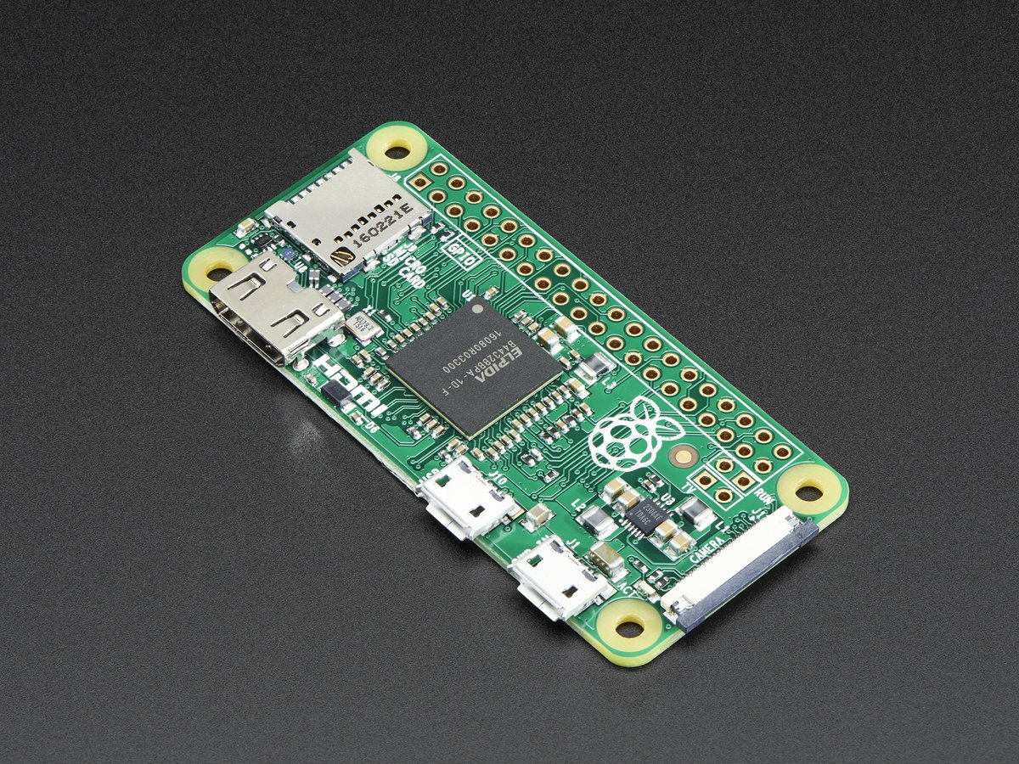
Microcontroller Update
Since MDR
  Code imported from B+ to Zero
Current State
  Simultaneously supports OLED Display & Wink Detector codes
Future Work
  Securely place in goggles
  (OPTIONAL): Add another Zero to distribute work
Notes:
Sanghoon

Slide 13
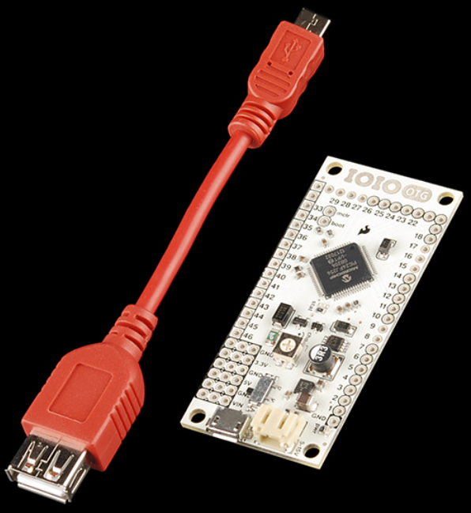
IOIO
Interface between Android phone and RPi
Connected Subsystems
  Android phone/App - Micro-USB B to USB Cable
  RPi
    Wink Detector - GPIO Ports/Wires
    Text Image Generator - Serial Ports/Wires
Notes:
Sanghoon

Slide 14
IOIO Requirements
Provide Serial Data Transmission
  Stable USB Connection
AOA Protocol over ADB Protocol
Read GPIO input and Analog Input
Write GPIO Output
Notes:
Minwo

Slide 15
IOIO Update
Since MDR
  Demonstrated simple GPIO output tests
Current State
  Receives GPIO signals from RPi
  Sends serial signals to RPi
Future Work
  PCB Placement
Notes:
Sanghoon

Slide 16
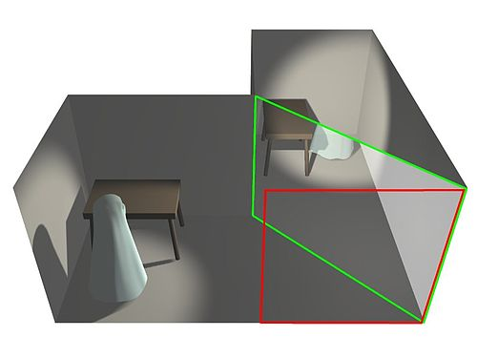
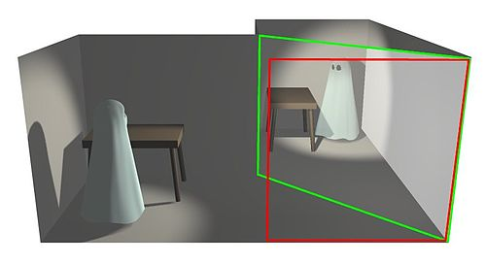
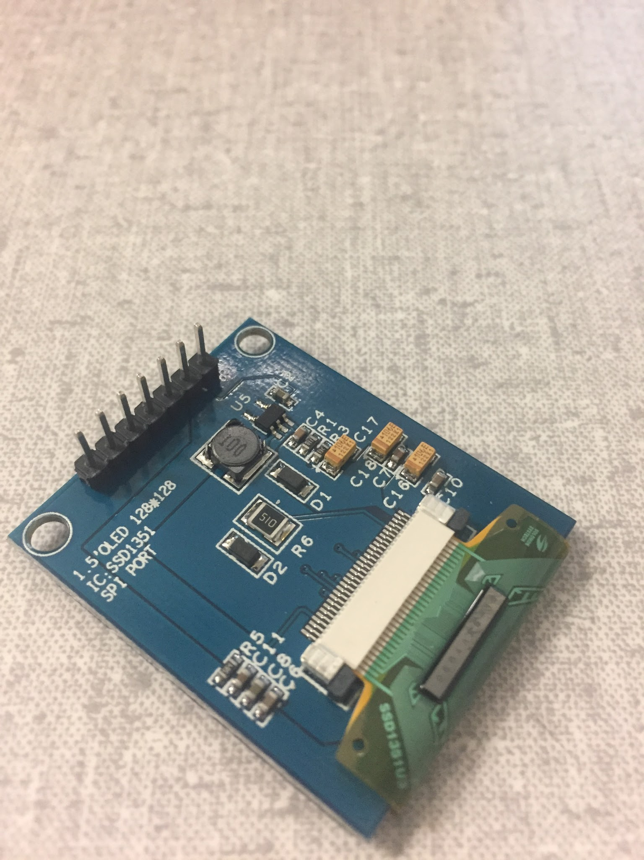
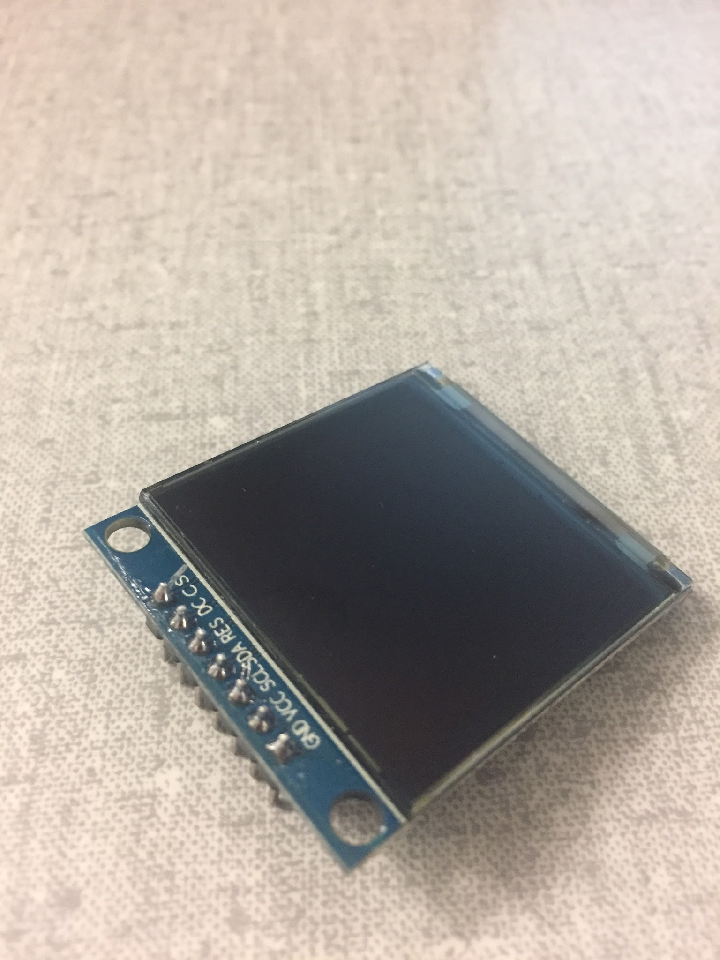
Augmented Reality Display
SSD1351 OLED Display (128x128)
Utilizes Pepper’s Ghost Effect
5 Pins connected to the PI Zero
  4 SPI pins
  1 GPIO pin
Uses SPI Bus on PI Zero
Notes:
David

Slide 17
Augmented Reality Display
Update:
Integrated into PI Zero
Displays Text generated from the phone
Mirrored for accurate reflected display
Still need to focus the reflected display more for the user’s viewing
Requirements:
Focused & legible display (Image & Text)
Minimum: 90 nits = 90 cd/m²
Target Range: 100 - 200 nits = 100 - 200 cd/m²
Operating temperature range: -20°C to 30°C
Size: less than 50mm x 50mm
Power Consumption: less than 1W
*The candela per square metre (cd/m2) is the derived SI unit of luminance. The unit is based on the candela, the SI unit of luminous intensity, and the square metre, the SI unit of area. Nit (nt) is a non-SI name also used for this unit (1 nt = 1 cd/m2). (Wikipedia)
Notes:
David

Slide 18
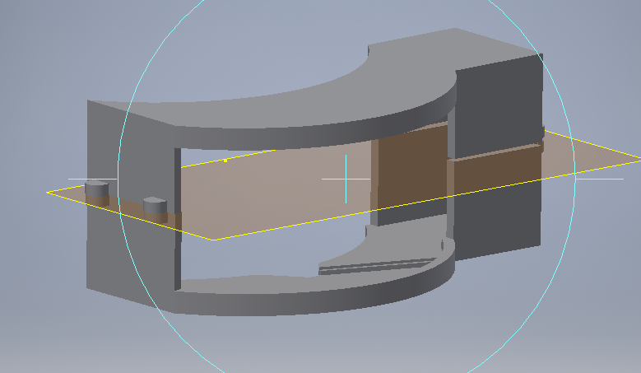
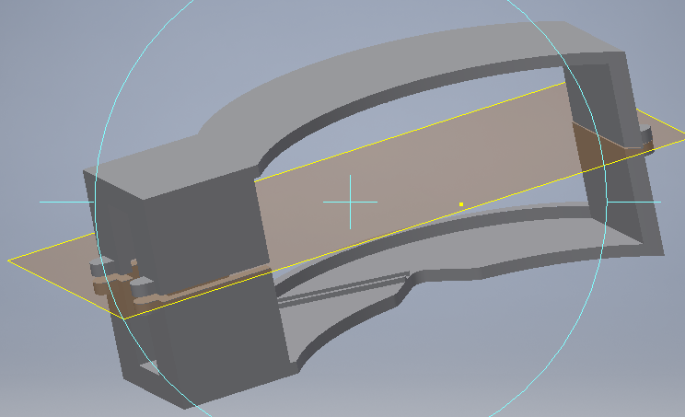
Casing
Notes:
Jori

Slide 19
Casing
Houses several subsystems
Fits between the user’s goggles and their face
Connected Subsystems
  Display - Housed
  Wink Detector - Affects Calibration
  Camera - Housed
  Raspberry Pi - Attached Externally
  Power System - Attached Externally
Notes:
Jori

Slide 20
Casing Requirements
Lightweight (less than 100g when combined with components)
Houses relevant HUDWare components
  Camera, OLED, Reflector Screen, MCU, Power System
Desired operational temperature range (-20°C to 30°C)
Unobstructed view
Notes:
Jori

Slide 21
Casing Update
Since MDR
  Designed
  Assembled
  Integrated
Current State
  Printed out
  Assembled
Future Work
  Improving Ergonomics
  Housing Power System and MCU internally
  Reduce Visual Obstruction
Notes:
Jori

Slide 22
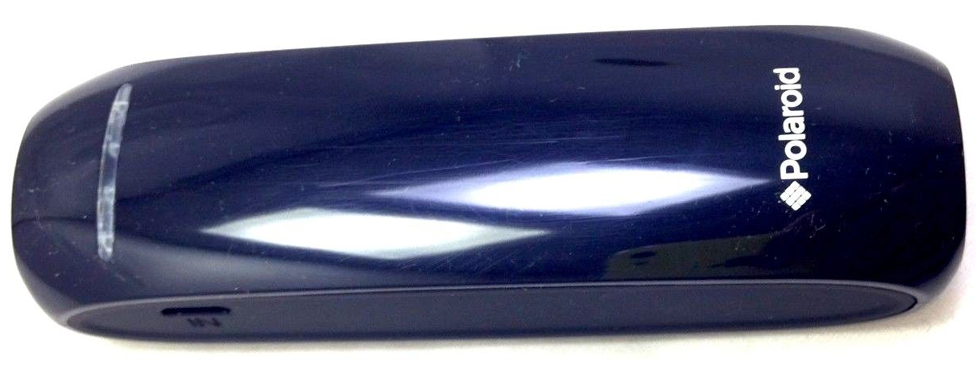
Power System
Supplies power to MCU, IOIO, Camera, and OLED
Connected Subsystems
  MCU, IOIO - wired
  OLED, Camera - indirectly via MCU
Notes:
David

Slide 23
Power System Requirements
Supplies whole system with power for 4 hours
  (Active Mode) Estimates 4Wh or 800mAh
  Idle Mode:
    33.6 mA to IOIO
    140 mA to RPi
  Active Mode:
    60 mA to IOIO
    140 mA to RPi
Notes:
David

Slide 24
Power System Update
Battery can successfully power all systems at once
Supplies 2200 mAh
  Required 800 mAh for 4 hours
Future Work
  Testing
Notes:
David

Slide 25
Wink Detector
Uses the camera and image processing to detect winks by the user
Connected subsystems
  MCU - Located inside
  IOIO - GPIO connections
  Camera - Wired connection
Notes:
Jori

Slide 26
Wink Detector Requirements
Accurate - Reads at least 90% of frames correctly
Quick - Reads frame in 0.25 seconds or less
Min 2FPS - Total time between image capture and analysis less than .5 seconds
Output control signals to the phone
Notes:
Jori

Slide 27
Wink Detector Update
Since MDR
  GPIO signals to IOIO generated
Current State
  Detects circles and generates appropriate control signals
  Averages 6.5 fps
    reduced to half to reduce jitter
Future Work
  Calibration in final setup
  Testing
  Streamlining
Notes:
Jori

Slide 28
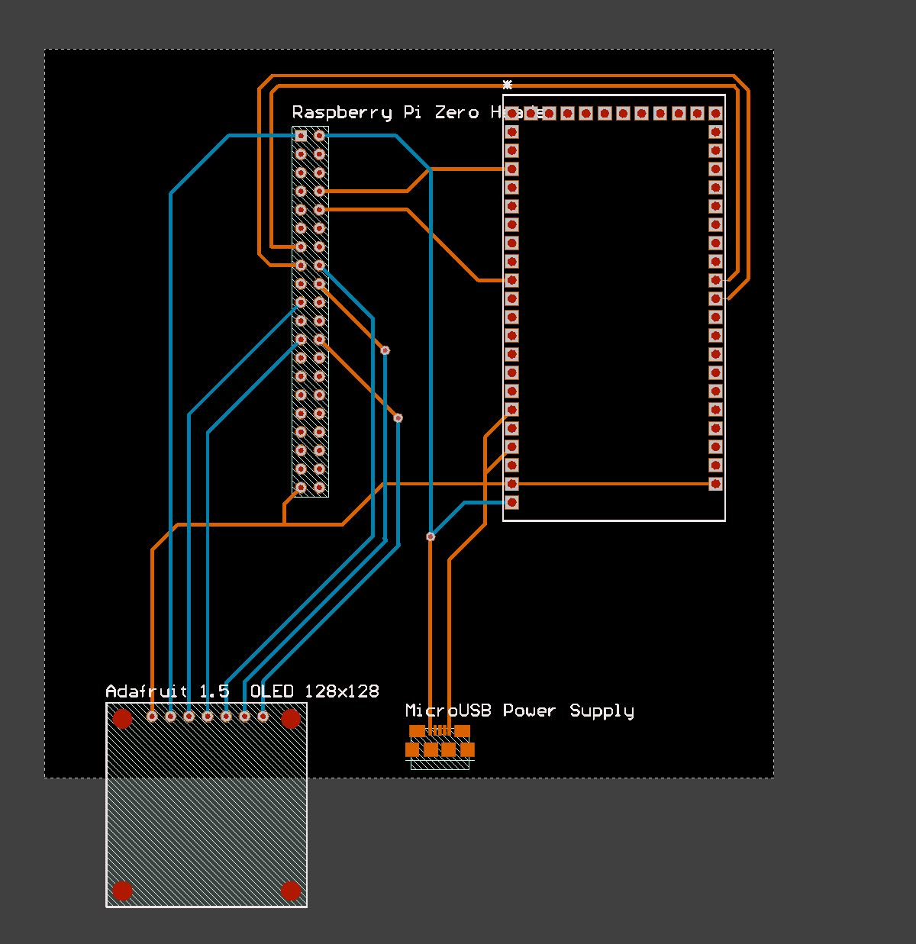
PCB Layout (Preliminary)
Notes:
David

Slide 29
PCB
Future Considerations:
Adding a power button
Fabricated
Notes:
David

Slide 30
Deliverables For CDR
Full app functionality
Communication to and from phone
  Controls to the phone
  Text from the phone
Power system setup
Prototype setup
  Goggles setup with camera and display
  Microcontroller switched to RPi Zero
PCB board layout
Notes:
Minwo

Slide 31
Proposed Deliverables For FDR
PCB fabricated
Full product assembled
  All parts integrated in casing
  Phone App
  Projection clearly visible
  Wink Detection allows for easy control
Notes:
Sanghoon

Slide 32
Demonstration

Slide 33
Backup Slides

Slide 34
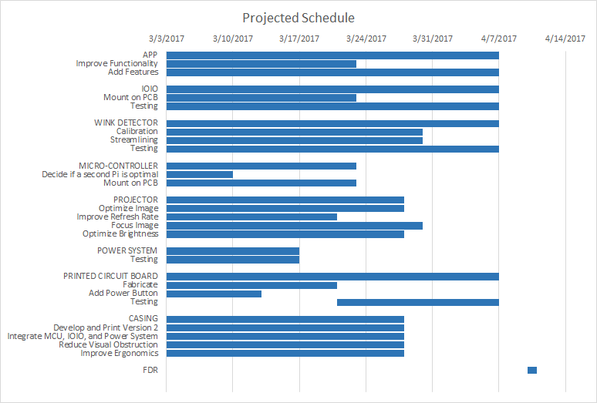
Gantt Chart

Slide 35
Budget
Spent so far
  $49.49
Upcoming costs
  PCB - $100
  Fisheye lens - $15
Breathing Room
  $335.51

Slide 36
Sample control system
Right wink: select item
Left wink: change item
Data
  Speed
  Gravity
  Back
Message
  Display
  Back
Music
  Pause/play
  Skip
  Back

Slide 37
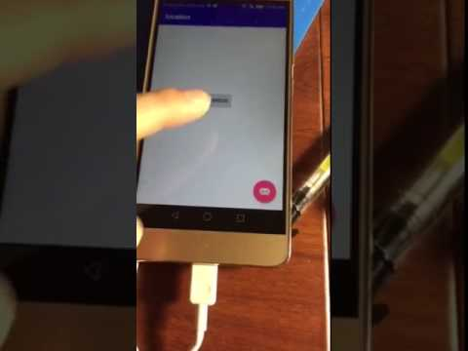
Phone GPS Test Video

Slide 38
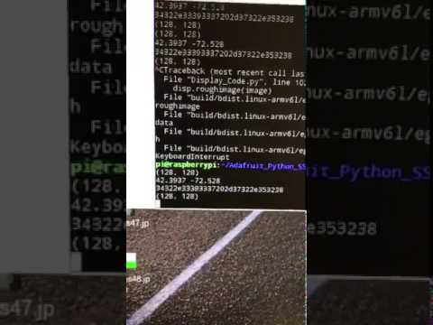
Display Code Test Video

